Slide 1
Natural Language Processing Specialization Word Embeddings by CBOW Model
(2021 Deeplearning.ai)
YangXi’s Reading Notes

Slide 2
Word Embeddings - Overview
Word Embedding is a common technique to encode words as numbers, with many applications
Machine translation, Information extraction, Question answering, Sentiment analysis, Semantic analogies and similarity, Classification of customer feedback, …
Word Embedding Vectors
Represent word in low dimensions (fewer than V)
Encode semantic meaning
Classical word embedding methods
Word2vec (Google, 2013)
Continuous bag-of-words (CBOW) (2013): learns to predict the center word given some context
Continuous skip-gram / Skip-gram with negative sampling (SGNS): learns to predict the surrounding
Global Vectors (GloVe) (Standford, 2014): factorizes the logarithms of the word-cooccurrence matrix
fastText (Facebook, 2016): skip-gram model representing words as an n-gram of characters
Supports out-of-vocabulary (OOV) words
Suitable to use average word embeddings to represent phrases and sentences.
Deep Learning, Contextual Embeddings
A word can have different embeddings based on the context; support for polysemy
BERT (Google, 2018): bi-directional encoder representations from transformers
ELMO (Allen Institute for AI, 2018): embeddings from language models
GPT-2 (OpenAI, 2018): Generative pre-training-2

Slide 3
Train Word Embeddings
Two components for training word embeddings
Corpus of text: provide the context
Say, if you want to train on Shakespeare, you should use the original full text
It can be general (e.g., Wikipedia) or specialized in a domain (e.g., law books)
Before training, you need to transform the text into integers / vectors
Embedding Method
The model performs a learning task, and the main by-products are the word embeddings.
The task is self-supervised
The input data (corpus) is unlabeled, while the data itself provides the context to make up the labels
Dimension of the word vectors
Usually a few hundreds or larger

Slide 4
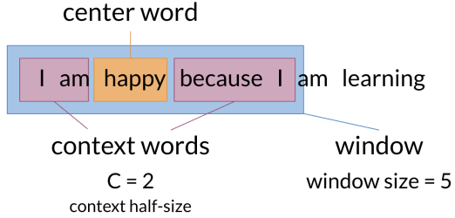
Continuous Bag of Words (CBOW) – Training Set
The rationale of CBOW is, two words are related semantically, if they are surrounded by similar sets of words in various sentences
For example, “The little dog / puppy / hound is barking”
Prepare the Training Set
To predict each center word, take C context words before and after it.
C is called context half-size
Window Size: size of the center word plus the context words
There we will use one-hot-encoding
Context words vector: average of the context words.

Slide 5
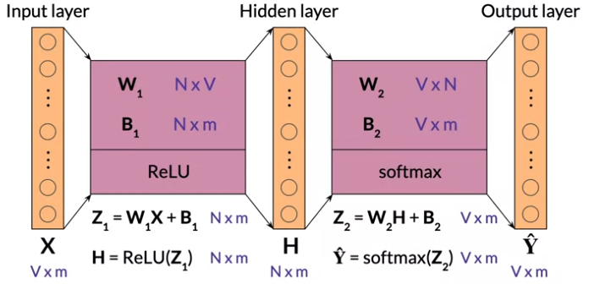
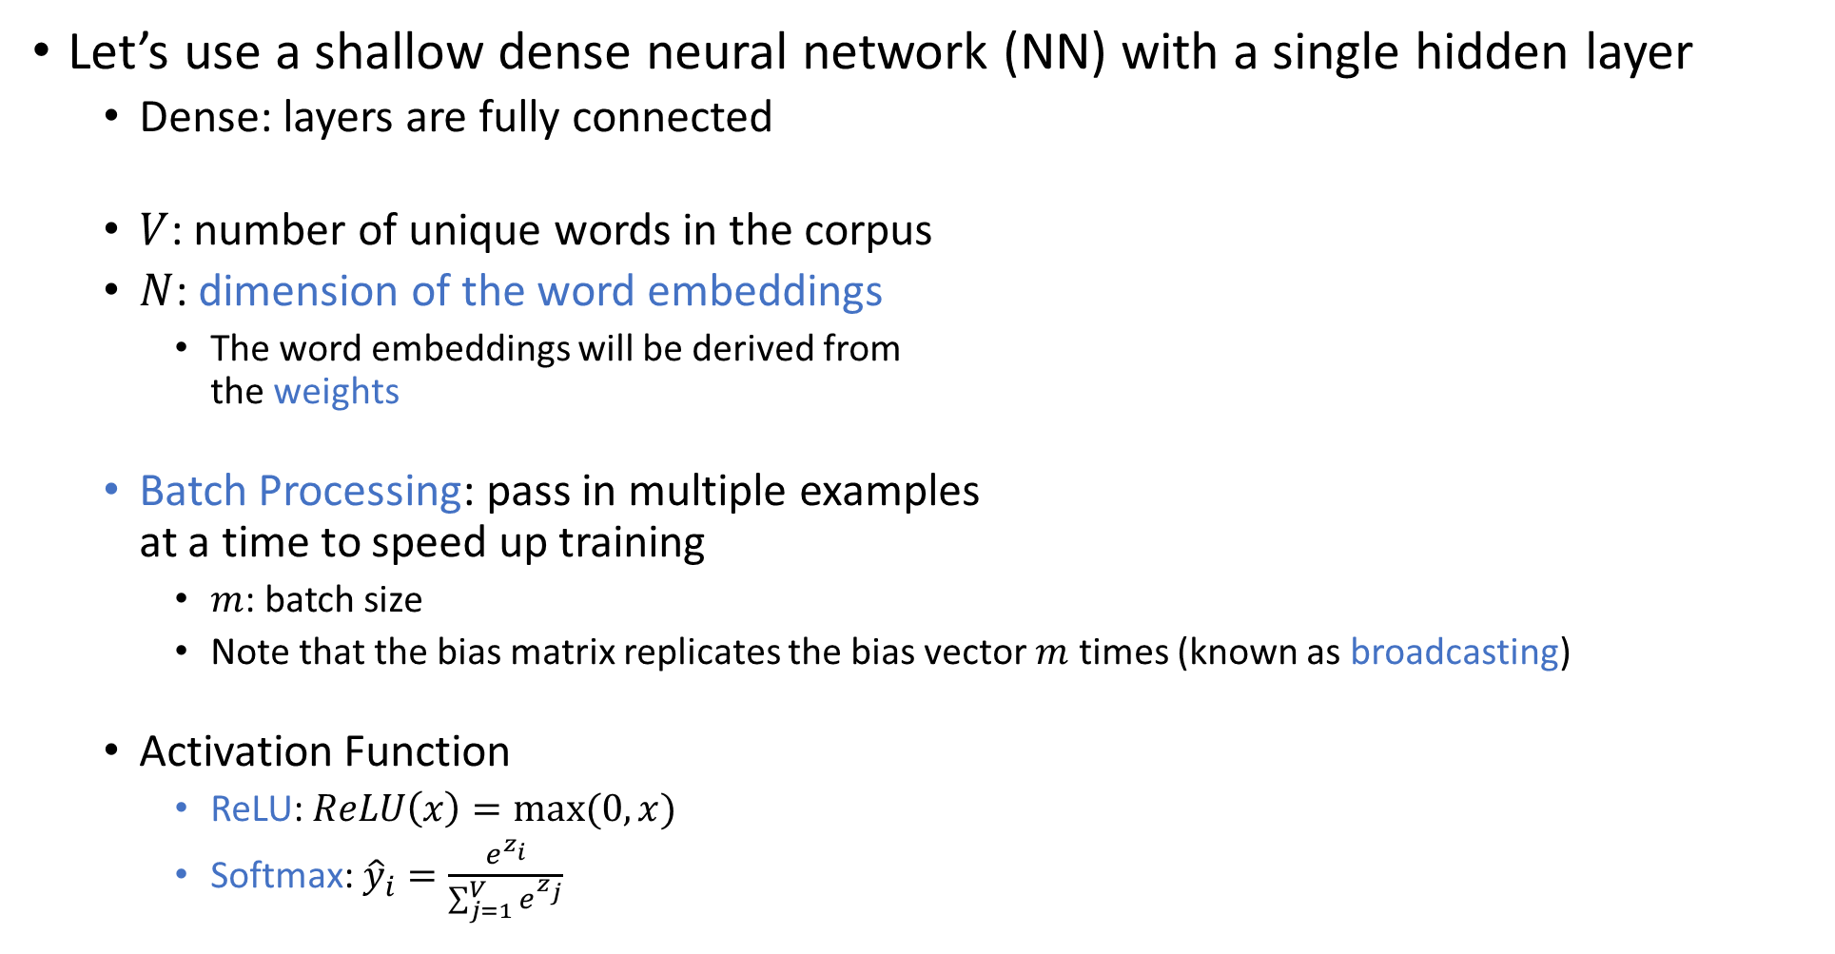
Continuous Bag of Words (CBOW) – Architecture
Let’s use a shallow dense neural network (NN) with a single hidden layer
Dense: layers are fully connected
$V$: number of unique words in the corpus
$N$: dimension of the word embeddings
The word embeddings will be derived from the weights
Batch Processing: pass in multiple examples at a time to speed up training
$m$: batch size
Note that the bias matrix replicates the bias vector $m$ times (known as broadcasting)
Activation Function
ReLU: $ReLU\left(x\right)=max⁡(0,x)$
Softmax: ${\hat{y}}_{i}=\frac{e^{z_{i}}}{\sum_{j=1}^{V}{e^{z_{j}}}}$

Slide 6
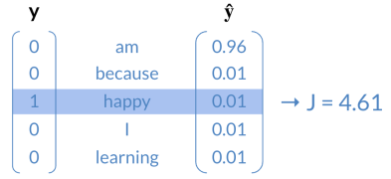
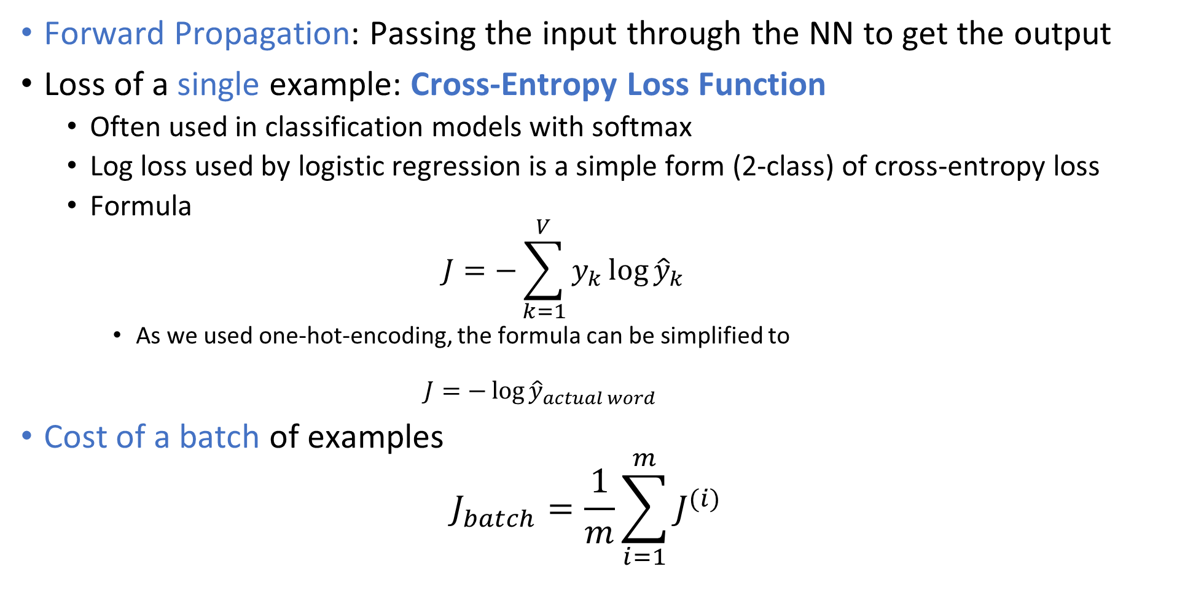
CBOW – Forward Propagation and Loss Function
Forward Propagation: Passing the input through the NN to get the output
Loss of a single example: Cross-Entropy Loss Function
Often used in classification models with softmax
Log loss used by logistic regression is a simple form (2-class) of cross-entropy loss
Formula $J=−\sum_{k=1}^{V}{y_{k}\log{{\hat{y}}_{k}}}$
As we used one-hot-encoding, the formula can be simplified to $J=−\log{{\hat{y}}_{actual word}}$
Cost of a batch of examples $J_{batch}=\frac{1}{m}\sum_{i=1}^{m}{J^{(i)}}$

Slide 7
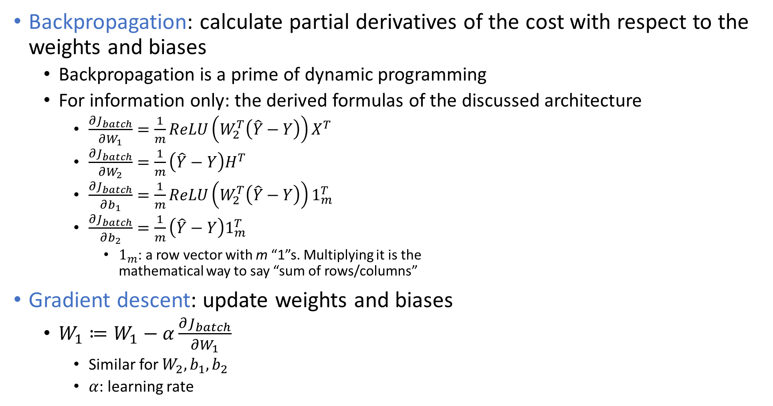
CBOW – Backpropagation and Gradient Descent
Backpropagation: calculate partial derivatives of the cost with respect to the weights and biases
Backpropagation is a prime of dynamic programming
For information only: the derived formulas of the discussed architecture
$\frac{∂J_{batch}}{∂W_{1}}=\frac{1}{m}ReLU\left(W_{2}^{T}\left(\hat{Y}−Y\right)\right)X^{T}$
$\frac{∂J_{batch}}{∂W_{2}}=\frac{1}{m}\left(\hat{Y}−Y\right)H^{T}$
$\frac{∂J_{batch}}{∂b_{1}}=\frac{1}{m}ReLU\left(W_{2}^{T}\left(\hat{Y}−Y\right)\right)1_{m}^{T}$
$\frac{∂J_{batch}}{∂b_{2}}=\frac{1}{m}\left(\hat{Y}−Y\right)1_{m}^{T}$
$1_{m}$: a row vector with m “1”s. Multiplying it is the mathematical way to say “sum of rows/columns”
Gradient descent: update weights and biases
$W_{1}≔W_{1}−α\frac{∂J_{batch}}{∂W_{1}}$
Similar for $W_{2}, b_{1}, b_{2}$
$α$: learning rate

Slide 8
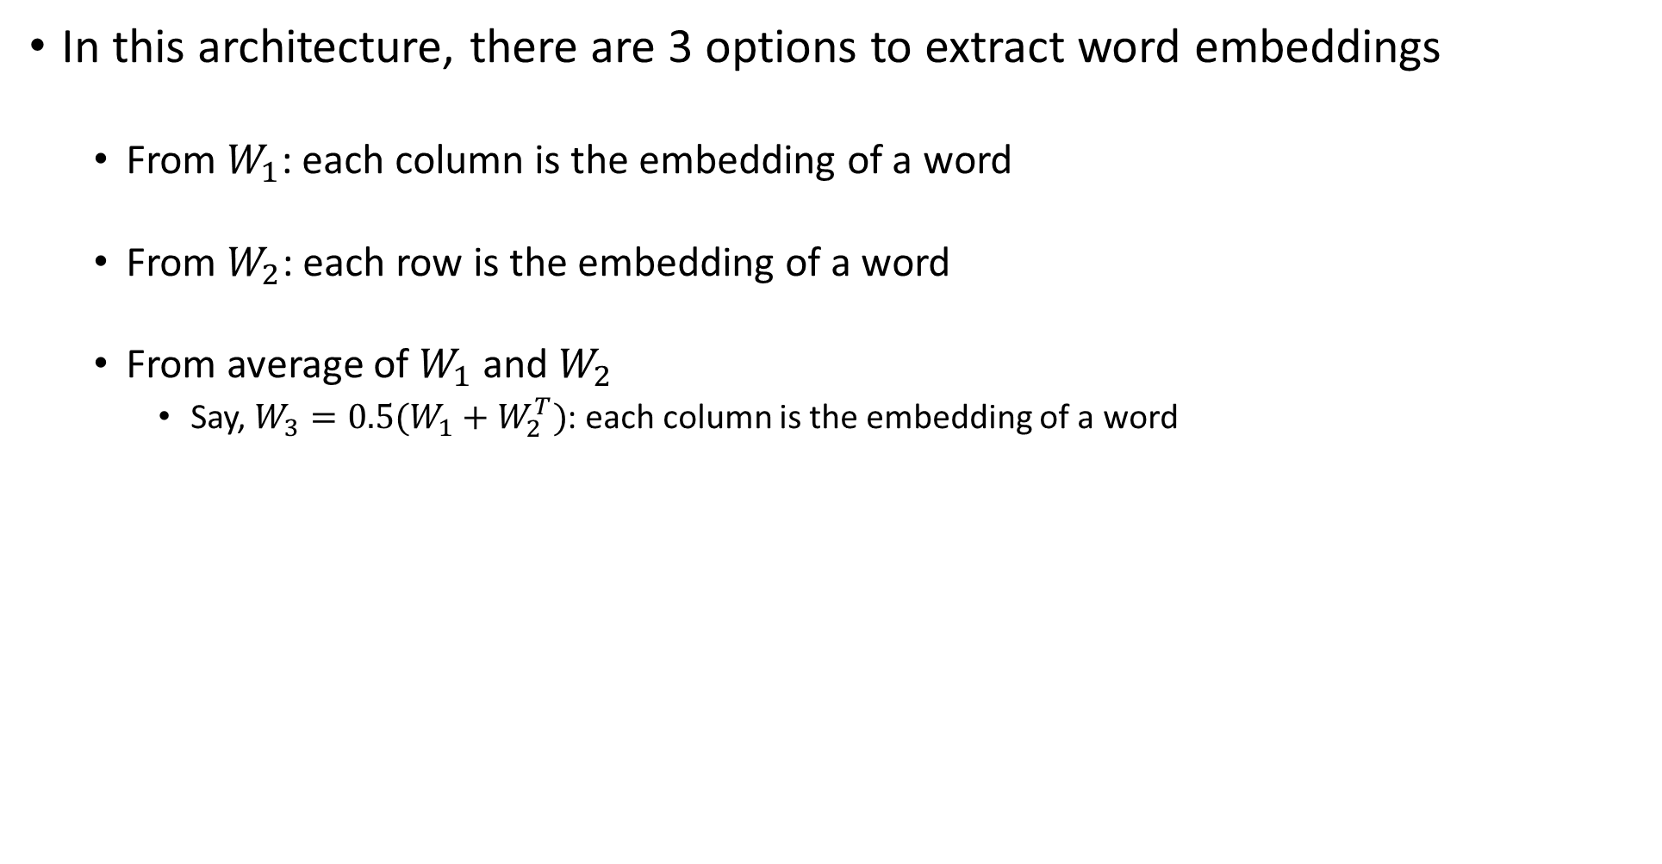
CBOW – Extracting Word Embedding Vectors
In this architecture, there are 3 options to extract word embeddings
From $W_{1}$: each column is the embedding of a word
From $W_{2}$: each row is the embedding of a word
From average of $W_{1}$ and $W_{2}$
Say, $W_{3}=0.5(W_{1}+W_{2}^{T})$: each column is the embedding of a word

Slide 9
Evaluating Word Embeddings
Intrinsic Evaluation: how well the word embeddings inherently capture the semantic (meaning) or syntactic (grammar) relationships between the words
Test with analogies
Semantic analogies: “France is to Paris, as Italy is to <?>”
Syntactic analogies: plurals, tenses, comparatives, for example “seen is to saw as been is to <?>”
Beware of ambiguity: there could be several correct answers
Use clustering to group similar word embeddings, and determine if the clusters capture related words
This could be automated using a human-made reference, such as a thesaurus
Visualization of the clusters will be helpful
Extrinsic Evaluation: Test the word embeddings on an external task
Use the performance metrics of the task as a proxy for the quality of word embeddings
This is the ultimate test to ensure the word embeddings are actually useful
Drawbacks include more time-consuming, difficult to troubleshoot errors
Examples
Named entity recognition: In “Tom eats an apple”, “Tom” is a “person”, and “apple” is an “item”

